Slide 1
CITY, UNIVERSITY OF LONDON MSc IN CYBER SECURITY
DESIGN AND IMPLEMENTATION OF AN ANTI-STALKING SYSTEM FOR AIRTAGS
By George J. A. ABAIDOO
Supervised by Dr. Nikos KOMNINOS
OCTOBER 8, 2022
1

Slide 2
OUTLINE
Introduction
Aims and Objectives
Relevance and Beneficiaries
Critical Context
Methods
Identifying AirTag
Extracting Identifying Token
Scan Filter
Measured Power and Distance Estimation
Alert System
Testing and Dataset Creation
Results
Discussion and Conclusion
References
2

Slide 3
INTRODUCTION
Apple, one of the biggest technology companies in the world, announced the AirTag in 2020 and released it in 2021
The AirTag is a tracking device used to help users track their items such as keys, backpack etc. and are synchronized with a user’s iPhone, enabling them to do the tracking using the Find My app (Apple, 2020)
Because of its powerful tracking capabilities, the AirTag can be used for malicious activities most notably the unauthorized tracking of other people and their items. There have many reported cases of the AirTag being used this way (Mac and Hill, 2021)
Apple put in measures to address these concerns, but they are not comprehensive enough. The AirTag plays a sound after being separated from its owner for 8-24 hours. On iPhones alerts are given in case of suspected stalking, but they are not reliable and frequent (Clover et al, 2021).
3

Slide 4
INTRODUCTION
Apple released an app for android “Tracker Detect” to help users detect malicious AirTags, but it is not too sufficient because its scan period is very short and makes the experience manual. (Mehrotra, 2021)
The AirTag is a Bluetooth Low Energy (BLE) devices that broadcasts Bluetooth signals, and BLE devices are tricky to be tracked due to techniques such as Address Randomization (Becker et al, 2019)
This project aimed at providing a reliable mechanism to detect AirTags and possibility of stalking using them and informing potential victim timely. The result hopefully improves on the automatic aspect of detecting potential stalking on android devices
4

Slide 5
AIMS & OBJECTIVES
The aim of this project is to design and implement an Android application for anti-stalking of AirTags by detecting potential stalking with AirTags and alerting the user through notification
The AirTag, a BLE device, advertises its packet to announce its presence
. The requirement here is to extract and use an Identifying Token from the advertising packet that can be used to universially and distinctively detect AirTags
5

Slide 6
AIMS & OBJECTIVES
The objectives of this project are:
To derive an exclusive Identifying Token of AirTags to be able to uniquely identify the device
To design and implement an Android Application using Identifying Token to detect AirTags and alert timely
To test and analyze if the system accurately detects AirTags from other BLE devices
6

Slide 7
RELEVANCE & BENEFICIARIES
With the privacy, safety and security implications of the malicious usage of the AirTag, many users will benefit from improvement in these disciplines aforementioned:
It will be advantageous to manufacturers and other App developers involved in the development of anti-stalking schemes
This project will also be beneficial to other researchers looking to explore further work in anti-stalking and tracking using BLE technology
7

Slide 8
CRITICAL CONTEXT
AirTag Overview
Apple leveraged the extensive Find My network in designing the AirTag
Using Ultra-Wideband (UWB) technology, a user is able to keep track of the AirTag/items wherever it is
The AirTag plays a sound when misplaced and can send a notification when found by another iPhone user.
It can relay its location back to its owner in lost mode, and can provide contact details of the owner when scanned with NFC

Slide 9
CRITICAL CONTEXT
AirTag Reverse Engineering by (Catley, 2022)
He observed the various states of the AirTag and the behaviour of the advertising packet after being registered
Byte Number | 0 | 1 | 2-3 | 4 | 5 | 6 | 7-29 | 30 | 31
Value | 0x1E | 0xFF | 0x004C | 0x12 | 0x19 | 0x10 | Varied | 0-3 | Varied

Slide 10
CRITICAL CONTEXT
Tracking Anonymized Bluetooth Devices by (Becker, Li and Starobinski, 2019)
They considered techniques in passive analysis of signals of BLE devices where one observes advertising packet but never actively modifies the traffic.
They proposed that Identifying Tokens can be found by analysing raw Advertising Payload and extracting a sequence of bytes which are long enough to distinguish one device from another
This is identifying token ensures uniqueness, prevents collision as much as possible, and can be used to track any individual device in that class of devices

Slide 11
Methods – Identifying AirTag
Using Android BLE API, a simple scanning android application was implemented to detect nearby BLE devices
Nearby devices were discovered, and the Device Name, MAC Address, RSSI value, Byte Information were extracted the devices
The Advertising Packets(Byte Info) were analysed to identify which one belonged to the AirTag
After analysis, the AirTag was identified when comparing its packet with (Catley, 2022) and analysing the signal strength (RSSI).
Name | MAC Address | Advertising Packet
Unnamed | DB:2F:86:BF:09:8C | 0x1EFF4C00121910F0B9551C79E23EED5298A6EC89AC9ECC 0AD933856CAC0059
11

Slide 12
Methods – Identifying Token
The Manufacturer Specific Data (MSD) of the AirTag was extracted and analysed, since it was the data being broadcast in the packet as confirmed by (Catley, 2022)
THE MSD is the data associated with a particular manufacturer and is used by the manufacturer to add custom data into the packet (Silicon Labs)
After analysis, it was noted that the first 3 bytes of the MSD were always constant even though the remaining bytes changed.
Since they were always constant and long enough to distinguish themselves as Identifying Tokens, the Identifying Token of the AirTag was determined as (0x12, 0x19, 0x10) or (0x121910)
12

Slide 13
Methods – Scan Filter
A scan filter was constructed and implemented into the application using the Identifying Token determined
This was to detect BLE devices which have the characteristic features of the Identifying Token, ie, hopefully AirTags
13

Slide 14
Methods – Measured Power & Distance Estimation
The Measured Power (MP), one-metre RSSI, of the AirTag was not set and known, and was estimated through experimentation
The MP can be used to estimate the distance of a device away from a broadcaster in conjunction with RSSI
The MP was determined as -53.4 dBm
Using the formula below, the estimated distance of the device away from the AirTag could be determined:
Estimated Distance = 10^(MP – current RSSI))/(10 * N),
where N = 4.5 was used and implemented
14

Slide 15
Methods – Alert System
A notification alert system was implemented using Androids Notification API
A time period of one (1) minute before an alert was given, was used to simulate a period after detection of an AirTag
The notification priority type implemented was set at High Priority to make the alert process very evident
15

Slide 16
Methods – Testing & Dataset Creation
Experiments were carried out to test the success of the implemented system and each outcomes was recorded
100 data points were recorded for experiments to check if an AIrTag was correctly detected, and 100 to check if they were correctly not detected.
Variables recorded include the MAC Address, Advertising Data, MSD, RSSI over distances and Estimated Distance Measured over distances
The accuracy, precision, true positive rate and sensitivity of the system was determined
16

Slide 17
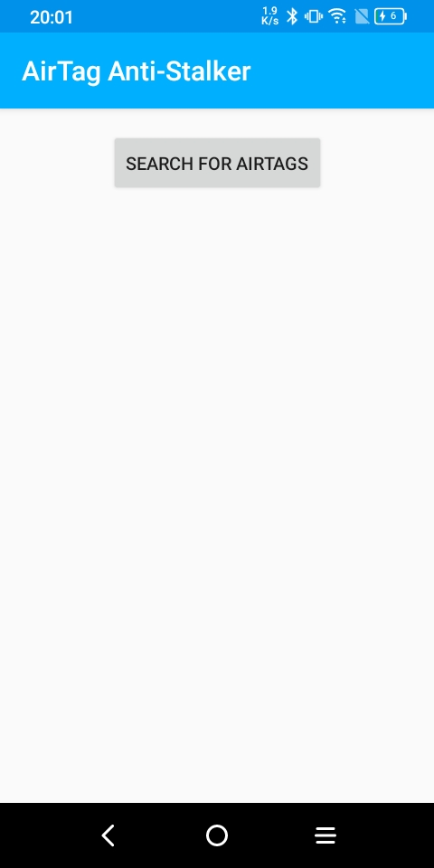
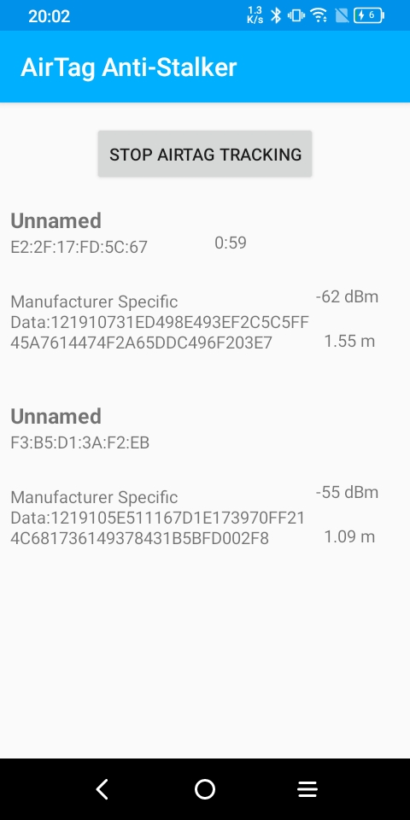
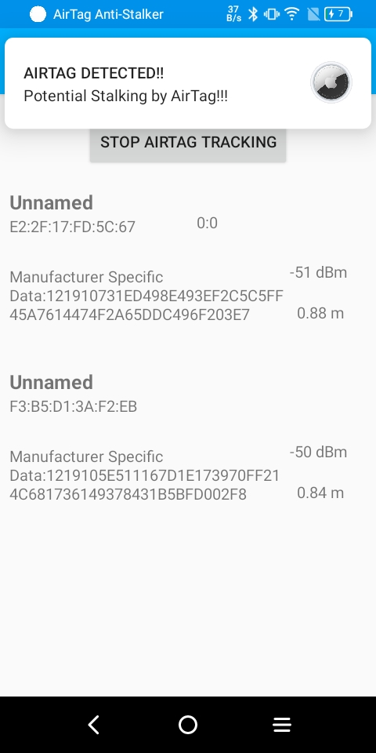
RESULTS
A simple android application capable of detecting AirTags was implemented
17

Slide 18
RESULTS
The use of Linear Regression Model (LRM) with parameters below, to predict the Measured Power was validated with
An optimum line of best fit
An optimum residual plot
An optimum Co-efficient of Determination value of about 0.678. (How much a variation in RSSI can be explained by a variation in distance)
LRM parameters:
Intercept : -48.67482470990923
Slope: -4.74352406
18

Slide 19
RESULTS
Naïve Bayes Algorithm, Support Vector Machine and Random Forest was used to determine the accuracy metrics of the system. The average values of the system are:
Accuracy – 99.17%
Precision – 0.992
Sensitivity – 0.992
False Positive Rate – 0.008
19

Slide 20
DISCUSSION & CONCLUSION
The results showed the design of a system capable of detecting AirTags and how effective the Identifying Token is at detecting AirTags uniquely.
The experiments performed to determine the validity of the system showed that the system has a high accuracy, precision, sensitivity and False Positive Rate.
The objectives set at the beginning of the project were largely met, i.e., deriving an Identifying Token for the AirTag, designing and implementing an android application using the Identifying tokens, and testing the system to validate its accuracy in detection.
20

Slide 21
DISCUSSION & CONCLUSION
Further work might be undertaken to determine if another Identifying Token can be derived or predicted for the AirTag.
. In evaluating the measured power, thorough modelling such as using a Polynomial Regression Model could be explored for its prediction
More work on stalker scenarios especially in commuting situations could be experimented on and analysed to discern an appropriate time value, or set of values, where stalking can be ascertained
Work could be done to implement an iOS version of the system to work on iPhones and iPads
More work on verification and validation could be done using many BLE devices to check the reliability of the results reported
21

Slide 22
REFERENCES
Apple (United Kingdom). 2020. AirTag. [online] Available at:
<https://www.apple.com/uk/airtag/>
Becker, J., Li, D. and Starobinski, D., 2019. Tracking Anonymized Bluetooth Devices.
Proceedings on Privacy Enhancing Technologies, 2019(3), pp.50-65.
Catley, A., 2022. Apple AirTag Reverse Engineering - Adam Catley. [online] Adamcatley.com.
Available at: https://adamcatley.com/AirTag.html
Clover, J., 2022. AirTags: Apple's Item Trackers - Everything We Know. [online] MacRumors.
Available at: <https://www.macrumors.com/guide/airtags/>
Clover, J., Hardwick, T., Charlton, H., Fathi, S. and Rossignol, J., 2021. Apple Enhancing AirTags
Anti-Stalking Measures With Android App and Shorter Sound Intervals. [online] MacRumors.
Available at: <https://www.macrumors.com/2021/06/03/apple-airtags-anti-stalking-measures/>
22

Slide 23
REFERENCES
Mac, R. and Hill, K., 2021. Are Apple AirTags Being Used to Track People and Steal Cars?.
[online] Nytimes.com. Available at: <https://www.nytimes.com/2021/12/30/technology/apple-airtags-tracking-stalking.html>
Matei, A., 2022. ‘I was just really scared’: Apple AirTags lead to stalking complaints. [online] the
Guardian. Available at: <https://www.theguardian.com/technology/2022/jan/20/apple-airtags-stalking-complaints-technology>
Mearian, L., 2019. Ultra Wideband (UWB) explained (and why it’s in the iPhone 11). [online]
Computerworld. Available at: <https://www.computerworld.com/article/3490037/ultra-wideband-explained-and-why-its-in-the-iphone-11.html>
Riyas, M., 2022. BLE-An overview. [online] Medium. Available at:
<https://medium.com/@muhamed.riyas/ble-an-overview-d524ceb73c94>
23

Slide 24
REFERENCES
Shah, R., 2022. Convert RSSI Value of the BLE (Bluetooth Low Energy) Beacons to Meters.
[online] Medium. Available at: <https://medium.com/beingcoders/convert-rssi-value-of-the-ble-bluetooth-low-energy-beacons-to-meters-63259f307283>
Silicon labs. 2022. [online] Available at: <https://docs.silabs.com/bluetooth/2.13/code-examples/stack-features/adv-and-scanning/adv-manufacturer-specific-data>
Statology. 2022. Understanding Heteroscedasticity in Regression Analysis - Statology. [online]
Available at: <https://www.statology.org/heteroscedasticity-regression/>
24

